Slide 1
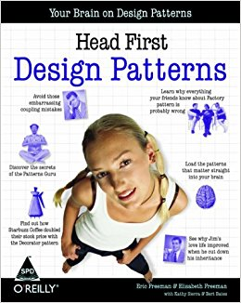
An Intro to Design Patterns
Literally regurgitating the contents of “Head First Design Patterns”
Notes:
We’ve had this book for almost a decade, but I had a skim through and I think it’s still one of the best books there is for getting good at OO (and thinking about code in general). So, I’ve completely ripped it off and am going to force-feed it to you.

Slide 2
What are Design Patterns?
Reusable solutions to common problems.
Notes:
So what are design patterns?

Slide 3
Huh?
AKA: Someone has already solved that problem you’re tackling.
Load up your brain with patterns and you’ll spot the problems (and solutions) quicker.
You will write better code that is more flexible and less prone to bugs.
You will have a shared vocabulary to discuss code.
Notes:
We’re rarely the first to solve an actual architecture problem.
But “common solutions to common problems” is perhaps a bit of an oversimplification. The art and value of design patterns is actually being able to know when you’re actually looking at a common problem.
This kind of stuff is what will have a major impact on the amount of time we have to spend on bugs, feedback and the number of times we feel the need to refactor code.
We can simplify and speed up discussions by having a shared vocabulary.

Slide 4

Meet Joe
Any resemblance to actual persons, living or dead, is entirely coincidental.
Notes:
(The developer in the book is actually called Joe :P)
Joe works for a company making the highly successful duck pond simulator SimUDuck.

Slide 5
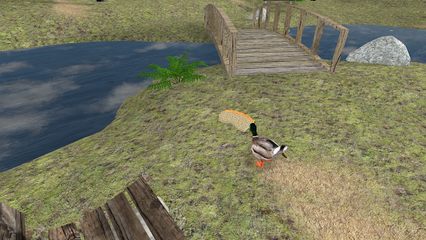
SimUDuck
Notes:
The game shows a duck pond and bunch of different varieties of ducks swimming and quacking around.
Lovely.

Slide 6
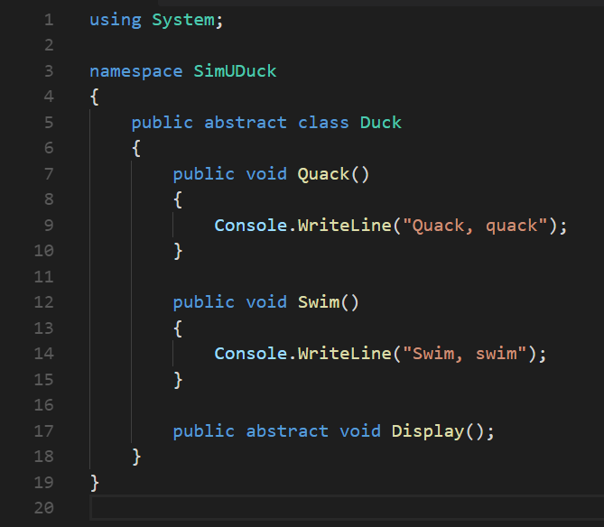
Notes:
The original designers used standard OO and created a Duck superclass from which all other ducks inherit:

Slide 7
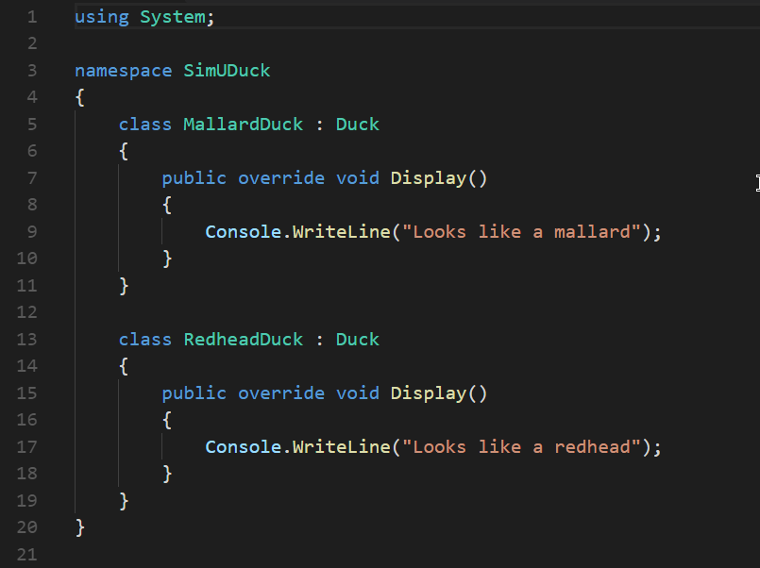
Notes:
Here we have two examples of ducks you can see in the game, Mallard and Redhead.
Of course they can swim and quack but they look different so their display methods are overridden.

Slide 8
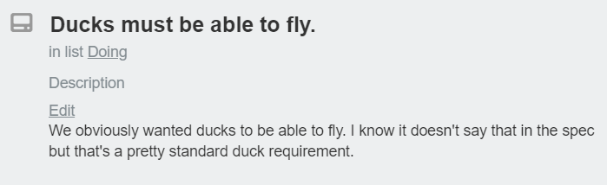
New requirement!
Notes:
The execs have decided that in order to wow the board, ducks really should be able to fly. They have announced this and will be doing a demo next week and it MUST be ready. Joe has been assigned to this feature and dives in.

Slide 9
No problemo…
I just need to add a fly() method in Duck then all the ducks will inherit it... I AM AN OOP GOD!
Notes:
Joe pulls down the latest code and dives in creating a fly method on the abstract Duck class.

Slide 10
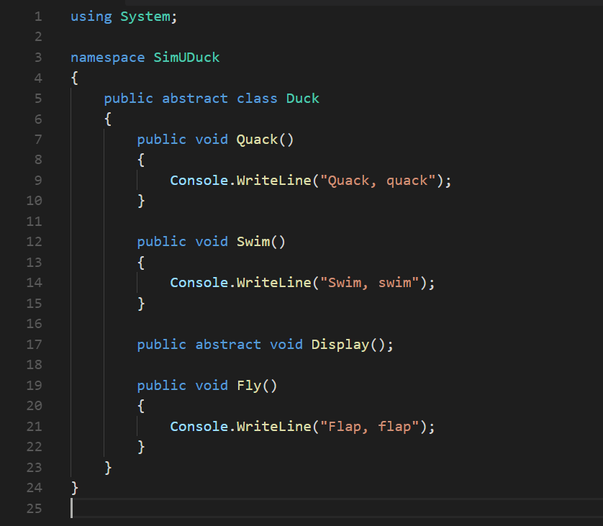
Notes:
Git push :smugface: Joe awaits his raise and promotion as the execs blow the minds of everyone at the product update meeting. But…

Slide 11
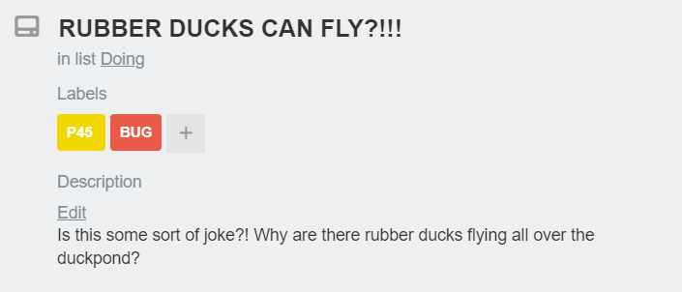
Uh oh….
Notes:
Oh noooo!
Joe hadn’t actually used the game and totally forgot about the other type of ducks in the game, rubber ducks!

Slide 12
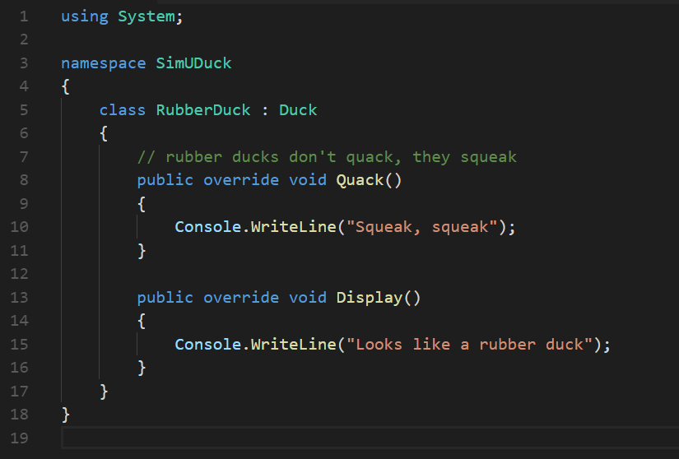
Notes:
Here’s our duck class, inheriting from Duck.
He hadn’t realised not ALL ducks should fly.
Interestingly this class also overrides the default quack behaviour because rubber ducks squeak, not quack.

Slide 13
Inheritance for the purpose of reuse has had a negative impact on maintenance
Notes:
Adding behaviour to a superclass led to adding behaviour that was not appropriate to some subclasses. :sadface:
So, Joe thinks about it…

Slide 14
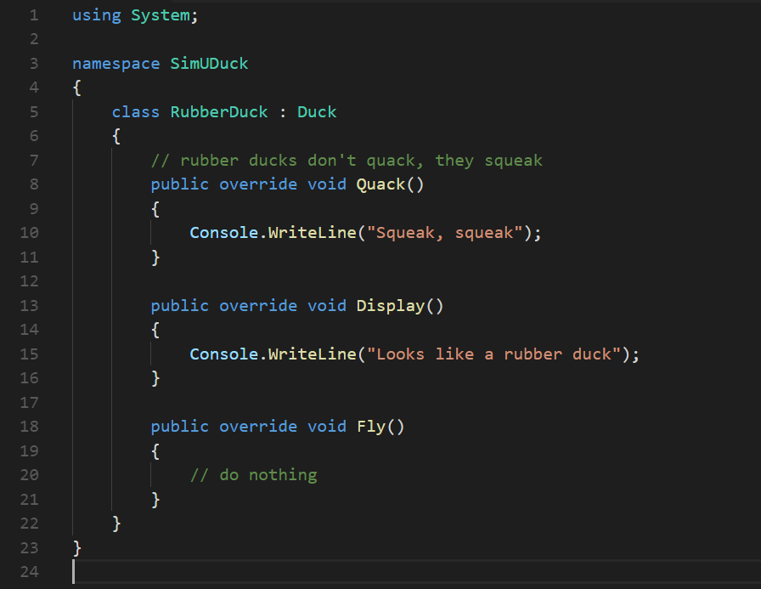
Notes:
He COULD just override the fly method on the rubber duck like they did with the quack method.
But what if we were to add something like a wooden decoy duck at some point?

Slide 15
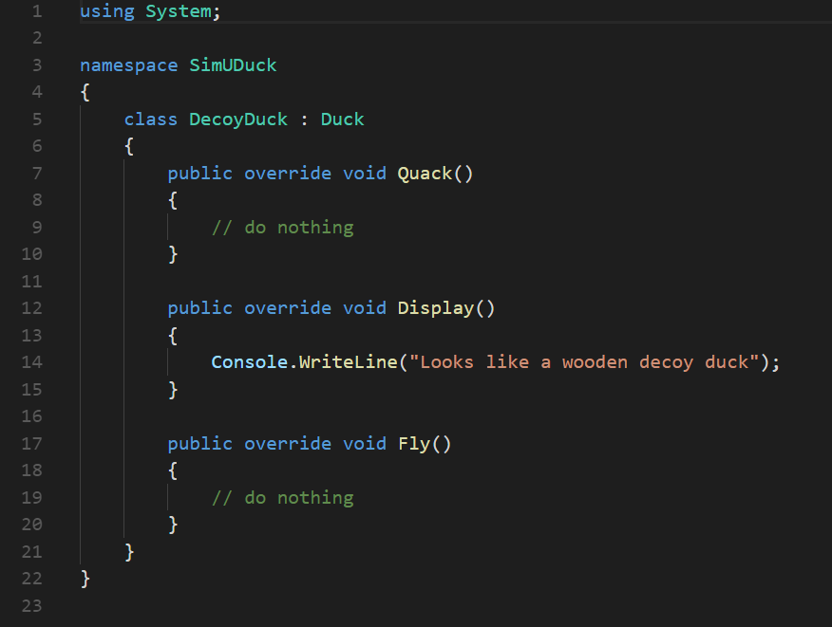
Notes:
We’re adding code to take functionality away, and we have to remember to explicitly do so every time we add a new type of duck.
This is getting a bit smelly :/

Slide 16

Quiz time!
Which of the following are disadvantages of inheritance?
Code is duplicated across subclasses
Runtime behaviour changes are difficult
We can’t make ducks dance
Hard to gain knowledge of all duck behaviours
Ducks can’t fly and quack at the same time
Changes can unintentionally affect other ducks
Notes:
So, back to Joe. He’s just been notified that the plan is they’re going to be launching an update every 3 months. Inheritance is definitely not looking like the right way to go. So…

Slide 17
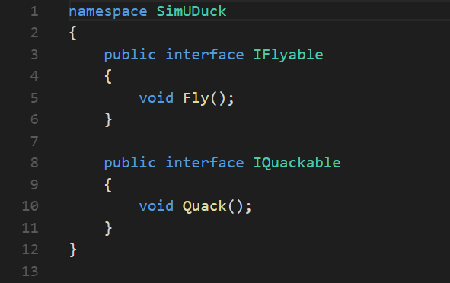
How about Interfaces?
Notes:
He could take the fly method out of Duck and create an IFlyable interface which only the relevant duck types implement. Whilst he’s there, he could do the same with quack as not all ducks quack.
What do you think?

Slide 18
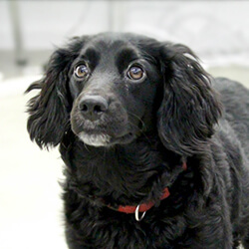
Let’s ask the lead developer…
That is, like, the dumbest idea you’ve come up with. Can you say “duplicate code”? If you thought having to override a few methods was bad, how you gonna feel when you need to make a little change to the flying behaviour… in all 48 of the flying Duck subclasses?!
Notes:
So no. Whilst this solves part of the problem, no flying rubber ducks. All we’ve done is swapped in a different maintenance problem because we’re not getting any code reuse and having to implement the logic over and over. Also, as we saw with the quack/squeak scenario, there might be different kinds of behaviours needed.

Slide 19
So what’s the solution?
DESIGN PATTERNS!?
Nope
Just good ol’ fashioned OO design principles

Slide 20

Strong and stable leadership
Wouldn’t it be dreamy if my minions could build software so that when we need to change it, we could do so with the least possible impact on the existing code? We could spend less time reworking code and more making cooler stuff…

Slide 21
The one constant in software dev…
Change
Notes:
No matter what you’re building, who for, what platform and no matter how well you’ve built it. Change is absolutely guaranteed with any project.

Slide 22
Catch up
Inheritance hasn’t worked out very well.
Behaviour is changing across subclasses and not required in all.
Interfaces allowed only appropriate subclasses to implement behaviour.
But we lost any code reuse meaning changes had to be made everywhere the behaviour was needed.

Slide 23
Design Principle #1
Take what varies and “encapsulate” it so it won’t affect the rest of your code.
The result? Fewer unintended consequences from code changes and more flexibility in your systems!
Identify the aspects of your application that vary and separate them from what stays the same.
Notes:
In other words, if you’ve got some aspect of your code that is changing, say with every new requirement, then you know you’ve got a behaviour that needs to be pulled out and separated from all the stuff that doesn’t change.
Can I alter or extend this, without affecting the rest of the code?

Slide 24
Design Patterns
All patterns provide a way to let some part of a system vary independently of all other parts
Notes:
This is the basis for almost every design pattern.
All patterns provide a way to let some part of a system vary independently of all other parts
So, let’s do this!

Slide 25
Separating what changes from what stays the same
We know that fly() and quack() are the parts of the Duck class that vary across ducks.
To separate these behaviours from the Duck class, we’ll pull both methods out of the Duck class and create a new set of classes to represent each behaviour.
Notes:
Where do we start? As far as we can tell, other than the problems with fly() and quack(), the Duck class is working well and there are no other parts of it that appear to vary or change frequently. So, other than a few slight changes, we’re going to pretty much leave the Duck class alone.
Now, to separate the “parts that change from those that stay the same,” we are going to create two sets of classes (totally apart from Duck), one for fly and one for quack. Each set of classes will hold all the implementations of the respective behaviour.
For instance, we might have one class that implements quacking, another that implements squeaking, and another that implements silence.

Slide 26
Fly and Quack behaviours
Keep things flexible
Assign behaviours to instances
Change behaviour dynamically
Notes:
So how are we going to design the set of classes that implement the fly and quack behaviors?
We’d like to keep things flexible; after all, it was the inflexibility in the duck behaviors that got us into trouble in the first place.
And we know that we want to assign behaviors to the instances of Duck. For example, we might want to instantiate a new MallardDuck instance and initialize it with a specific type of flying behavior.
And while we’re there, why not make sure that we can change the behavior of a duck dynamically? In other words, we should include behavior setter methods in the Duck classes so that we can change the MallardDuck’s flying behavior at runtime.
Given these goals, let’s look at our second design principle:

Slide 27
Design Principle #2
From now on, behaviours will live in a separate class—a class that implements a particular behaviour interface.
That way, classes won’t need to know any of the implementation details for their own behaviours.
Program to an interface, not an implementation.
Notes:
We’ll use an interface to represent each behavior—for instance, FlyBehavior and QuackBehavior—and each implementation of a behavior will implement one of those interfaces.
So this time it won’t be the Duck classes that will implement the flying and quacking interfaces. Instead, we’ll make a set of classes whose entire reason for living is to represent a behavior (for example, “squeaking”), and it’s the behavior class, rather than the Duck class, that will implement the behavior interface.
This is in contrast to the way we were doing things before, where a behavior came either from a concrete implementation in the superclass Duck, or by providing a specialized implementation in the subclass itself. In both cases we were relying on an implementation. We were locked into using that specific implementation and there was no room for changing the behavior (other than writing more code).

Slide 28
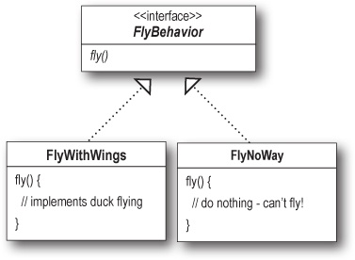
Notes:
With our new design, the Duck subclasses will use a behavior represented by an interface (FlyBehavior and QuackBehavior), so that the actual implementation of the behavior won’t be locked into the Duck subclass (in other words, the specific concrete behavior coded in the class that implements the FlyBehavior or QuackBehavior).
So we’ve abstracted what changes – the fly behaviour and we’ve implemented an interface.
“Program to an interface” really means “Program to a supertype.”
The word interface is overloaded here. There’s the concept of interface, but there’s also the construct interface. You can program to an interface, without having to actually use an interface. The point is to exploit polymorphism by programming to a supertype so that the actual runtime object isn’t locked into the code.

Slide 29
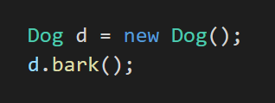
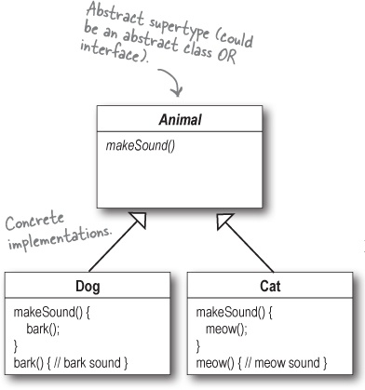
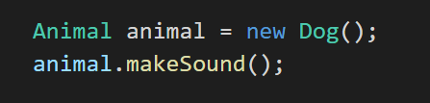
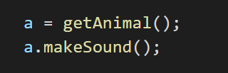
Notes:
This is probably old news to you, but just to make sure we’re all saying the same thing, here’s a simple example of using a polymorphic type—imagine an abstract class Animal, with two concrete implementations, Dog and Cat.
[step 1]
This is programming to an implementation - Declaring the variable “d” as type Dog (a concrete implementation of Animal) forces us to code to a concrete implementation.
[step 2]
But programming to an interface/supertype would be - We know it’s a Dog, but we can now use the animal reference polymorphically.
[step 3]
Even better, rather than hardcoding the instantiation of the subtype (like new Dog()) into the code, assign the concrete implementation object at runtime:

Slide 30
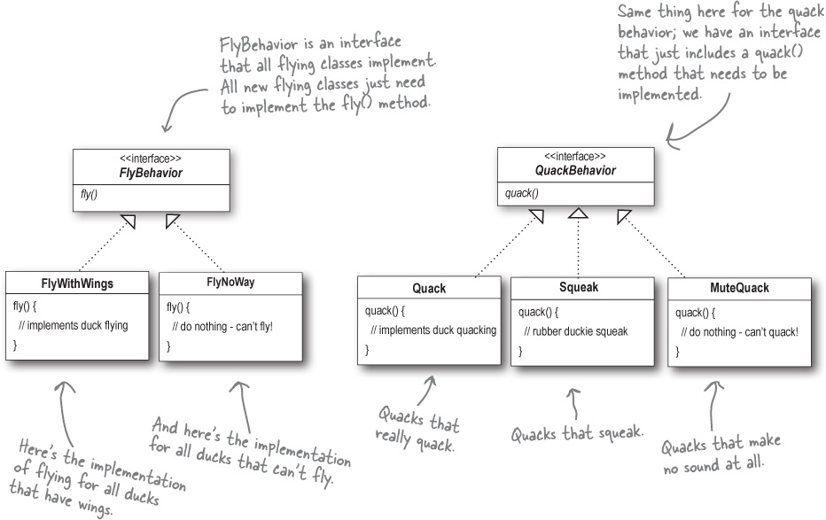
Notes:
With this design, other types of objects can reuse our fly and quack behaviors because these behaviors are no longer hidden away in our Duck classes!
And we can add new behaviors without modifying any of our existing behavior classes or touching any of the Duck classes that use flying behaviors.
So we get the benefit of REUSE without all the baggage that comes along with inheritance.

Slide 31
Quiz time!
How would we implement remote controlled flying?
What else might want to make use of our behaviours?
Notes:
Create a FlyRemoteControl behaviour and implement the interface
Duck Call whistle
Garden Bird Simulator

Slide 32
Integrating behaviours
We’re going to get our Duck class to delegate flying and quacking instead of relying on its own concrete implementation.

Slide 33
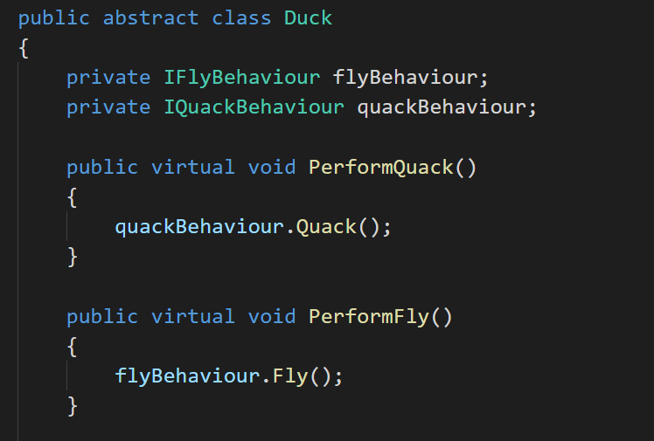
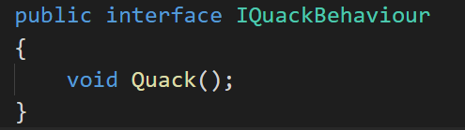
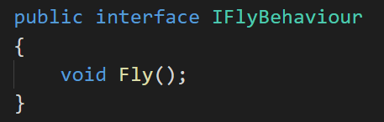
Notes:
First we’ll add two instance variables
We’ll also remove the fly() and quack() methods from the Duck class (and any subclasses) because we’ve moved this behavior out into the FlyBehavior and QuackBehavior classes.
In this part of the code we don’t care what kind of object it is, all we care about is that it knows how to quack()!

Slide 34
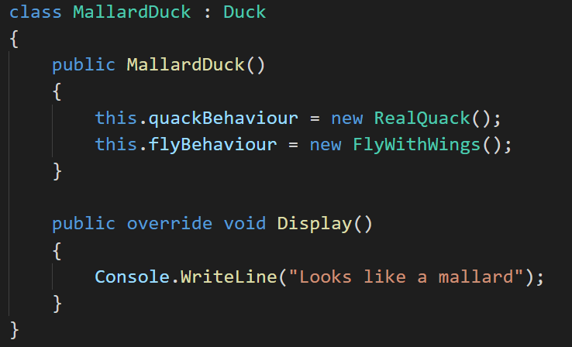
Notes:
So MallardDuck’s quack is a real live duck quack, not a squeak and not a mute quack. So what happens here? When a MallardDuck is instantiated, its constructor initializes the MallardDuck’s inherited quackBehavior instance variable to a new instance of type Quack (a QuackBehavior concrete implementation class).
And the same is true for the duck’s flying behavior—the MallardDuck’s constructor initializes the flyBehavior instance variable with an instance of type FlyWithWings (a FlyBehavior concrete implementation class).
“But aren’t we programming to a concrete implementation in the constructor?”
Good catch, that’s exactly what we’re doing... for now. In later discussions we’ll have more patterns in our toolbox that can help us fix it.
Still, notice that while we are setting the behaviors to concrete classes, we could easily change that at runtime.
So, we still have a lot of flexibility here, just we’re doing a poor job of initializing the instance variables in a flexible way.
But think about it: since the quackBehavior instance variable is an interface type, we could (through the magic of polymorphism) dynamically assign a different QuackBehavior implementation class at runtime. Which we’ll do in a minute.

Slide 35
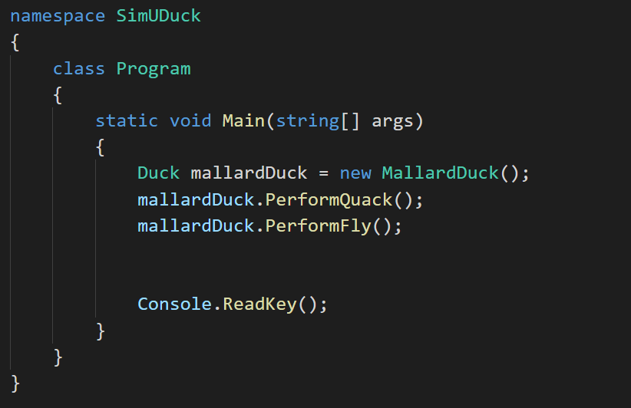
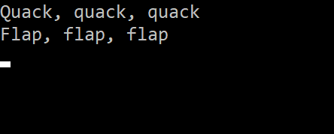
Notes:
Okay, so let’s create a little test app
And what do we get? Cool.
But, we’ve created this dynamic behaviour, but we’re not using it.

Slide 36
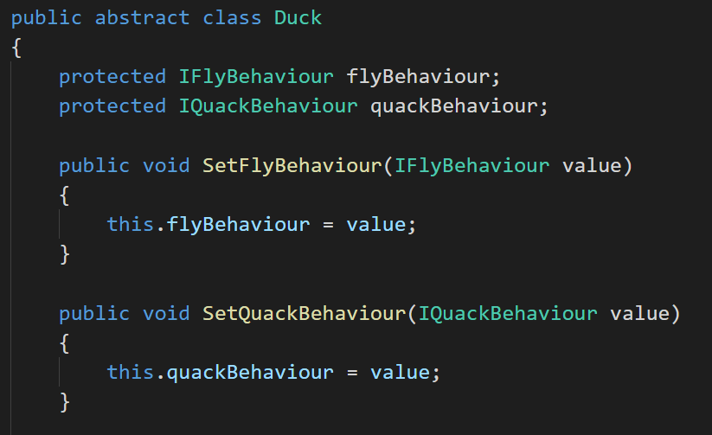
Notes:
Imagine you want to set the duck’s behavior type through a setter method on the duck subclass, rather than by instantiating it in the duck’s constructor.
We can call these methods anytime we want to change the behavior of a duck on the fly.

Slide 37
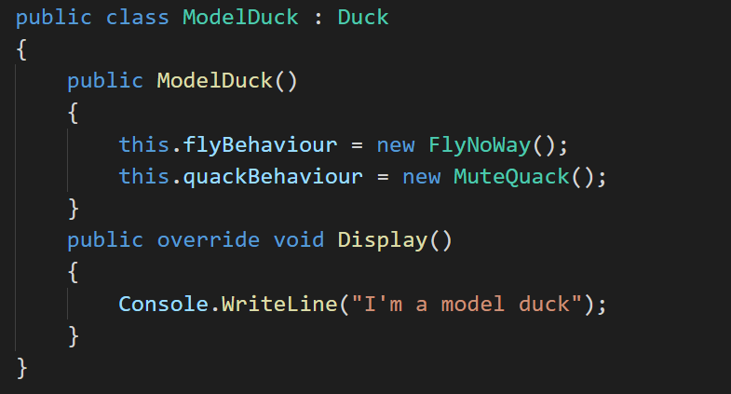
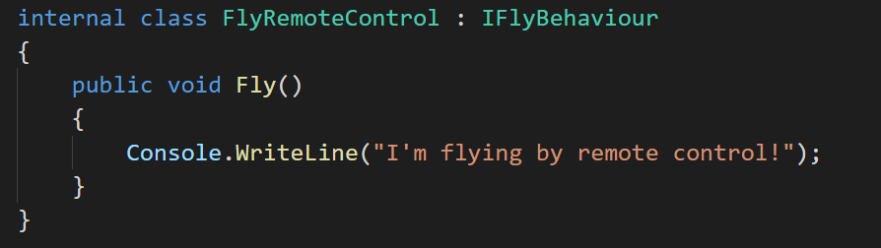
Notes:
To test this out, we create a new type of duck, a model duck.
We also create a new behaviour – flying by remote control.

Slide 38
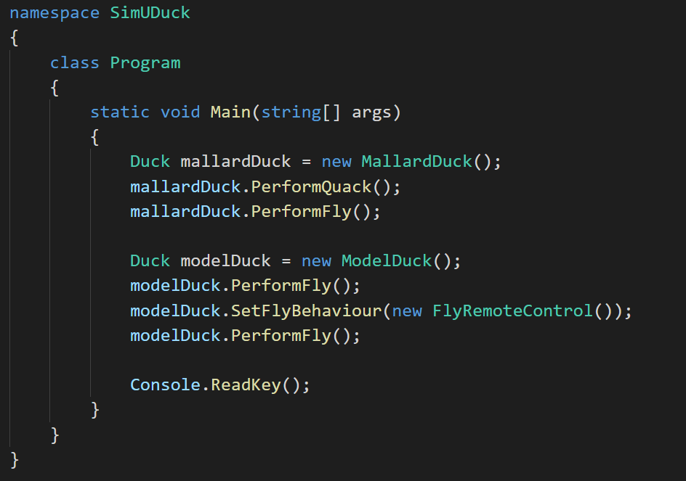
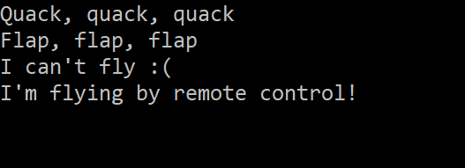
Notes:
Now we’ll update our test to create a model duck and change it’s behaviour at runtime…

Slide 39
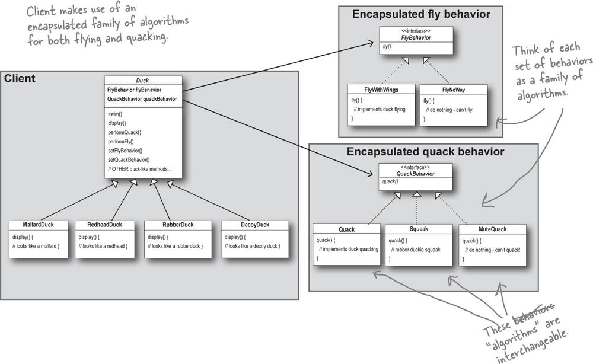
The big picture
Notes:
We have everything you’d expect: ducks extending Duck, fly behaviors implementing FlyBehavior, and quack behaviors implementing QuackBehavior.
Notice also that we’ve started to describe things a little differently. Instead of thinking of the duck behaviors as a set of behaviors, we’ll start thinking of them as a family of algorithms. Think about it: in the SimUDuck design, the algorithms represent things a duck would do (different ways of quacking or flying), but we could just as easily use the same techniques for a set of classes that implement the ways to compute state sales tax by different states.
Pay careful attention to the relationships between the classes, note the difference between IS-A and HAS-A
The HAS-A relationship is an interesting one: each duck has a FlyBehavior and a QuackBehavior to which it delegates flying and quacking.

Slide 40
Design Principle #3
Creating systems using composition gives a lot more flexibility. Not only does it let you encapsulate a family of algorithms into their own set of classes, but it also lets you change behaviour at runtime.
Composition is used in many design patterns.
Favour composition over inheritance.
Notes:
When you put two classes together like this you’re using composition. Instead of inheriting their behavior, the ducks get their behavior by being composed with the right behavior object.
This is an important technique; in fact, we’ve been using our third design principle:

Slide 41
Master and student
Master: Grasshopper, tell me what you have learned of the Object-Oriented ways.
Student: Master, I have learned that the promise of the object-oriented way is reuse.
Master: Grasshopper, continue...
Student: Master, through inheritance all good things may be reused and so we come to drastically cut development time like we swiftly cut bamboo in the woods.
Master: Grasshopper, is more time spent on code before or after development is complete?
Student: The answer is after, Master. We always spend more time maintaining and changing software than on initial development.
Master: So Grasshopper, should effort go into reuse above maintainability and extensibility?
Student: Master, I believe that there is truth in this.
Master: I can see that you still have much to learn. I would like for you to go and meditate on inheritance further. As you’ve seen, inheritance has its problems, and there are other ways of achieving reuse.
Notes:
Need a volunteer for some roleplay…

Slide 42
OUR FIRST DESIGN PATTERN!
The Strategy Pattern defines a family of algorithms, encapsulates each one, and makes them interchangeable. Strategy lets the algorithm vary independently from clients that use it.
The Strategy Pattern

Slide 43
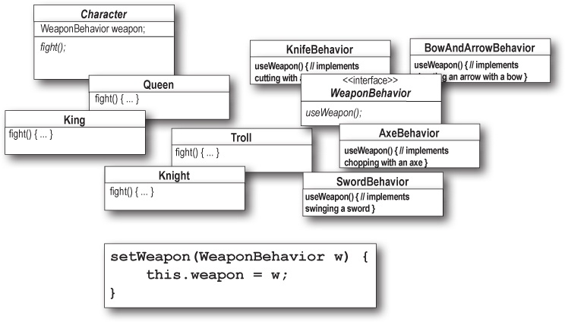
Quiz time!
Notes:
Identify one abstract class
one interface
eight classes
Extends
Implements
HAS-A
Put the method setWeapon() into the right class.

Slide 44
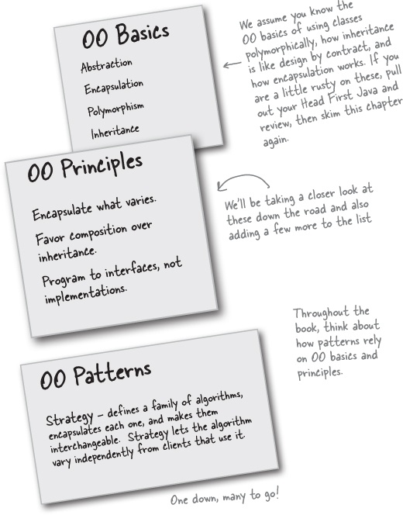
Toolbox
Knowing the OO basics does not make you a good OO designer.
Good OO designs are reusable, extensible, and maintainable.
Patterns show you how to build systems with good OO design qualities.
Patterns are proven object-oriented experience.
Patterns don’t give you code, they give you general solutions to design problems. You apply them to your specific application.
Patterns aren’t invented, they are discovered.
Most patterns and principles address issues of change in software.
Most patterns allow some part of a system to vary independently of all other parts.
We often try to take what varies in a system and encapsulate it.
Patterns provide a shared language that can maximize the value of your communication with other developers.

